Slide 1

GROUP G1
SAI RATHNAM CHAPPIDI
RAJESH GORRE
NANDA KUMAR MEDEPALLI
NIVAS REDDY YADIKA

Slide 2
Project Topic: Dog Breed Classification
With the help of advanced machine learning algorithms, we aim to accurately identify and classify different dog breeds from unstructured images.

Slide 3
Statement of Project Objectives
1
Accurate Identification
Develop an algorithm using TensorFlow and CNN to correctly identify the names of various dog breeds.
2
Unstructured Image Analysis
Implement a robust system that can analyze unstructured images and provide reliable breed predictions.
3
Evaluating Classifier Performance
Assess the performance of the developed classifier using appropriate metrics and comparisons.

Slide 4
Approach
1
Data Acquisition
Collect a diverse dataset of labeled dog images for training and validation purposes.
Preprocessing
2
Prepare the dataset by converting images and labels into Tensors, enhancing their usability.
3
CNN Modeling
Build a Convolutional Neural Network (CNN) model that can learn and classify dog breeds effectively.
Prediction
4
Apply the trained model to predict the names of dog breeds for test images with a high level of accuracy.

Slide 5

Deliverables
CNN Model Code
GitHub Repository
Code Walkthrough Video
Python code for the CNN model utilized in predicting dog breed names from images.
Access our GitHub repository containing the project code for further exploration and collaboration.
Check out our comprehensive video on YouTube that guides you through the implementation and functionality of the project code.

Slide 6

Evaluation Methodology
1. To ensure the effectiveness and accuracy of our classifier, we will evaluate the model using a well-established CNN technique.
This will involve training the model with labeled data and analyzing the breed predictions based on classifier accuracy.
2. A pre-trained ResNet model will be used to evaluate the model as it is beneficial for transfer learning.
In this technique, we can take the advantage of the knowledge learned by the ResNet model or a diverse dataset like ImageNet.
The final comparison will be presented through graphical representations for better understanding and visual interpretation.

Slide 7

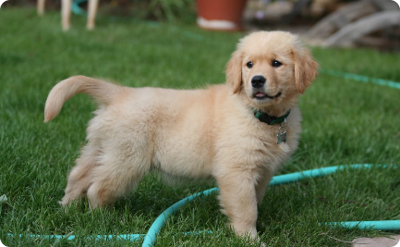
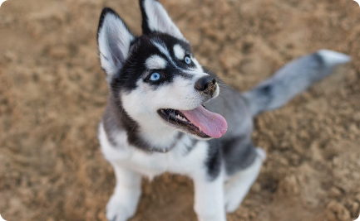
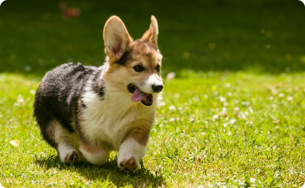
Dog Breeds Dataset
The dataset for our project consists of dog images and breeds labels. The breeds are divided into different categories.
Golden Retrievers
Huskies
Corgis
One of the most popular types of dogs in the dataset. Known for being friendly, loyal, and intelligent.
A breed known for its working ability, independent spirit, and capacity in cold weathers.
A dog breed with an affectionate, friendly, and outgoing personality. Recognized by their short legs.

Slide 8
Project Challenges
Like any project, there are challenges we encountered when building this dog breed classification model. One major challenge was dataset size, as we needed a large and diverse dataset to train the model effectively.
1
Data Quality
2
Computing Power
The quality of data can have a significant impact on model accuracy. It was time-consuming to select and prepare high-quality dog images.
Training the CNN and ResNet model demanded significant computation resources necessitating the use of cutting-edge GPUs or TPUs like Google Colab.

Slide 9

Conclusion
Thank you for joining us on this exciting journey to explore the realm of dog breed classification. Get ready to witness the amazing capabilities of machine learning and uncover the mysteries of our canine friends. Let's embark on this adventure together!

